Slide 1


Python vs C Style Printing
vs

Slide 2

Reference
Chapter 11 of Python for Finance (O'Reilly)
Youtube
Code

Slide 3
Specifier

Slide 4
Specifier
d - decimal
e - scientific notation
g - shortest notation of %f and %e
f - fraction
s - string
%% - percentage
fprintf_reference

Slide 5
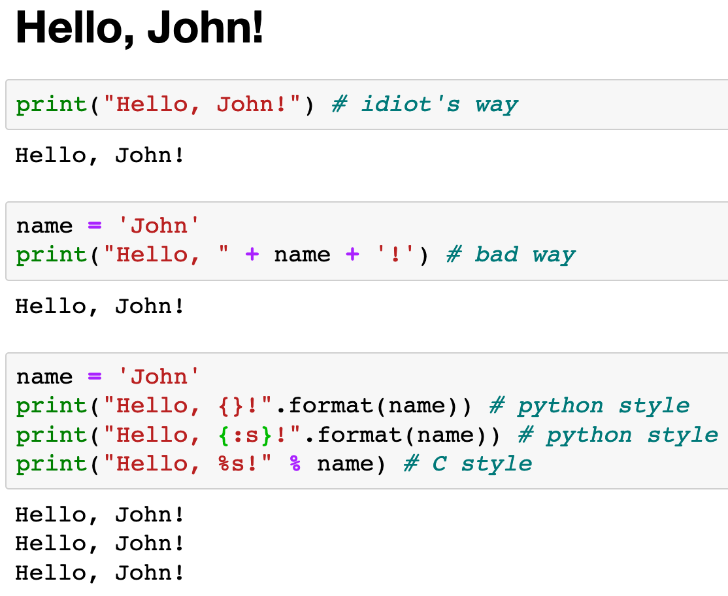

Slide 6
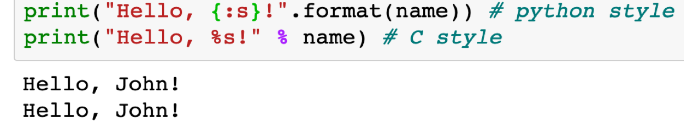

Slide 7
Python Style : {:}
C Style. : %

Slide 8
Python Style : .format()
C Style. : %

Slide 9
Specifier

Slide 10
Specifier
Specifier

Slide 11
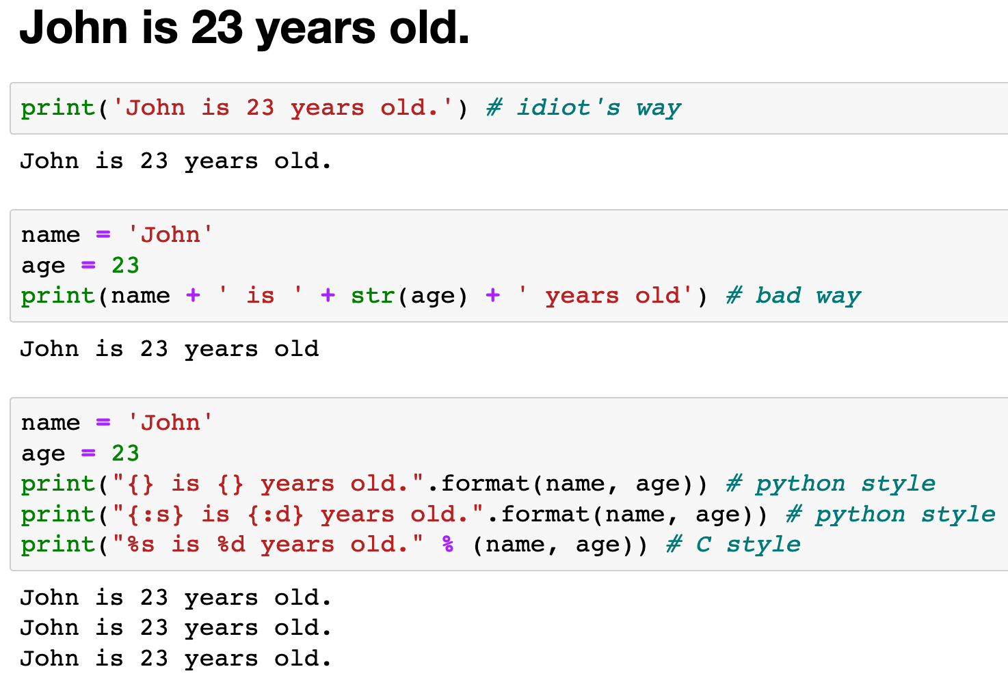

Slide 12
Specifier

Slide 13
Specifier

Slide 14
Format Specifier

Slide 15
Format Specifier
%-20.10s

Slide 16
Format Specifier
%-20.10s

Slide 17
Format Specifier
%-20.10s

Slide 18
Format Specifier
%-20.10s

Slide 19
Format Specifier
%-20.10s

Slide 20
Format Specifier
%-20.10s

Slide 21
Format Specifier
%-20.10s

Slide 22
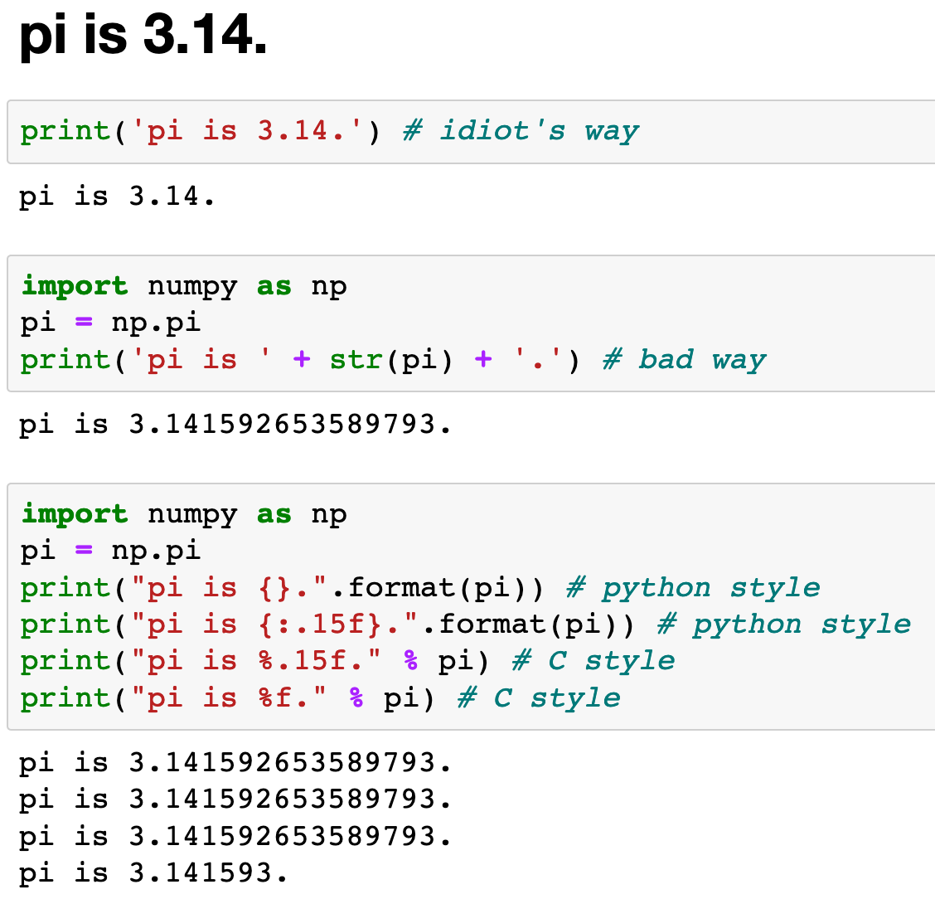

Slide 23
Specifier

Slide 24
Specifier

Slide 25
Specifier

Slide 26
Flags

Slide 27
Flags
+ - report result with a plus or minus sign
- - push to the left (not working properly in python style)
(space) - blank space is inserted before the value
0 - left-pads the number with zeroes (0) instead of spaces
fprintf_reference

Slide 28
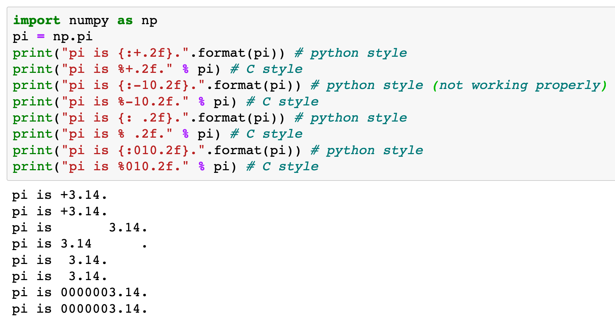

Slide 29
flag +

Slide 30
flag -

Slide 31
flag (space)

Slide 32
flag 0

Slide 33
Width

Slide 34
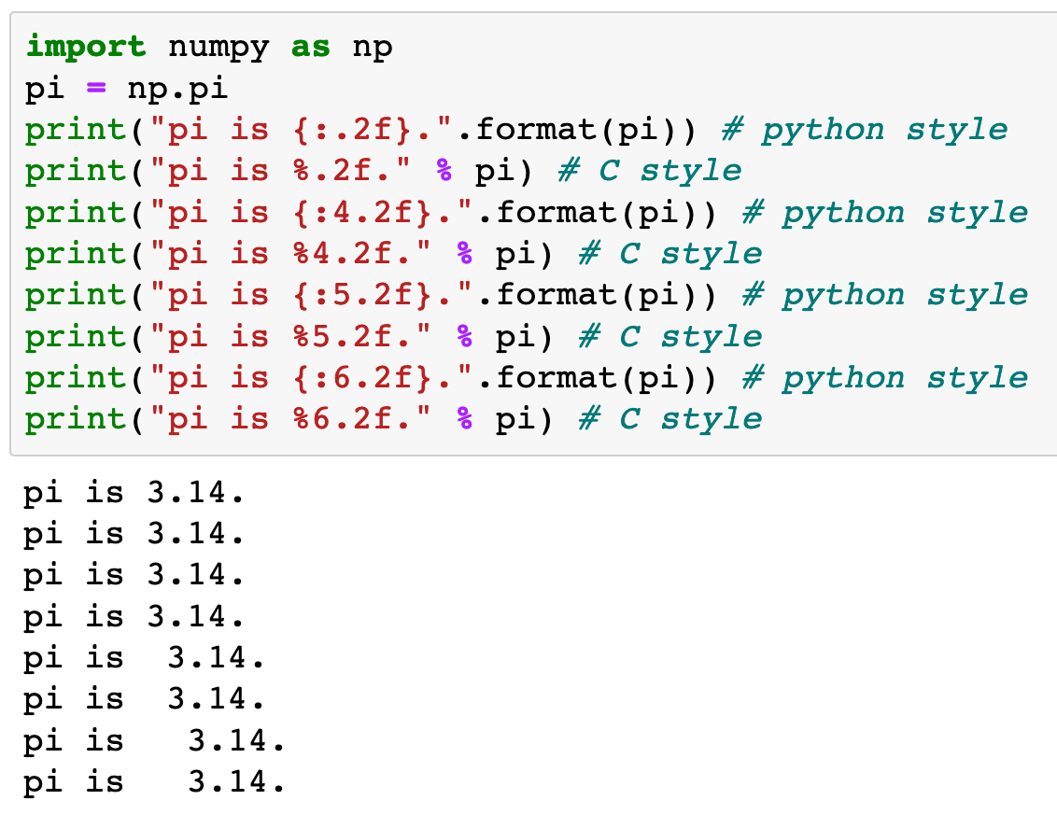

Slide 35
width 4

Slide 36
width 5

Slide 37
width 6

Slide 38
Length

Slide 39
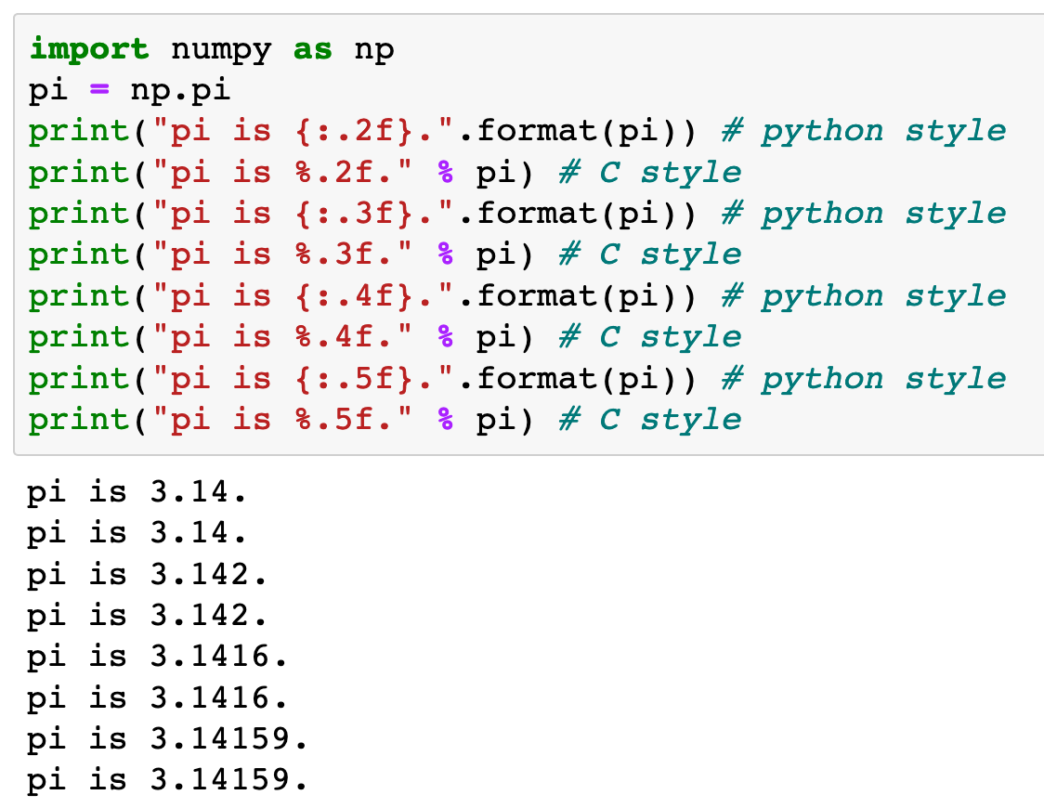

Slide 40
length 2

Slide 41
length 3

Slide 42
length 4

Slide 43
length 5

Slide 44
Specifier

Slide 45
specifier f

Slide 46
specifier f

Slide 47
How to push Left or Right

Slide 48
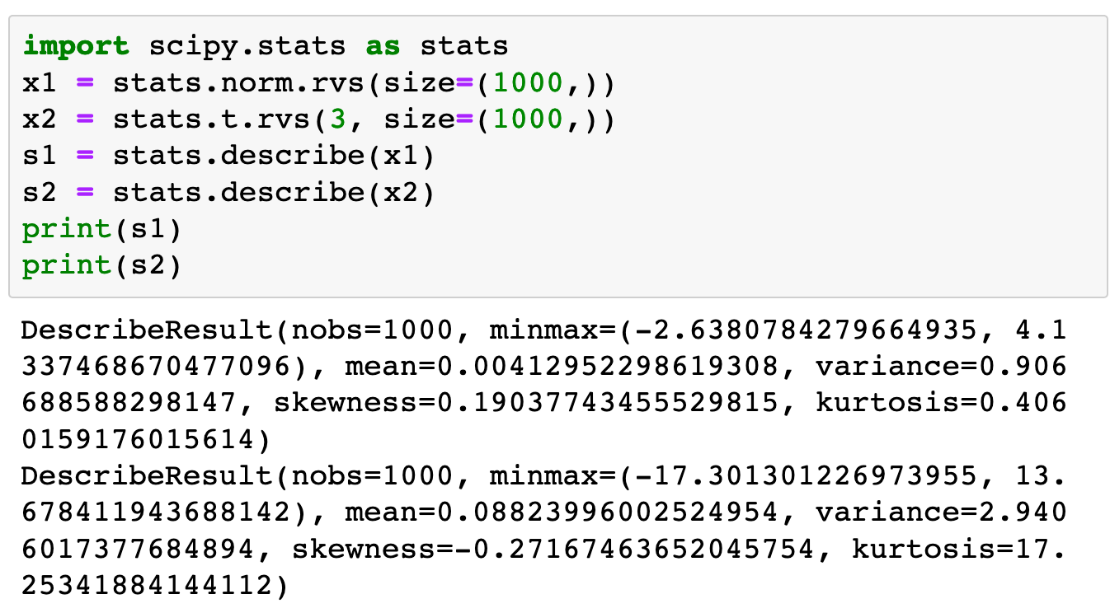

Slide 49
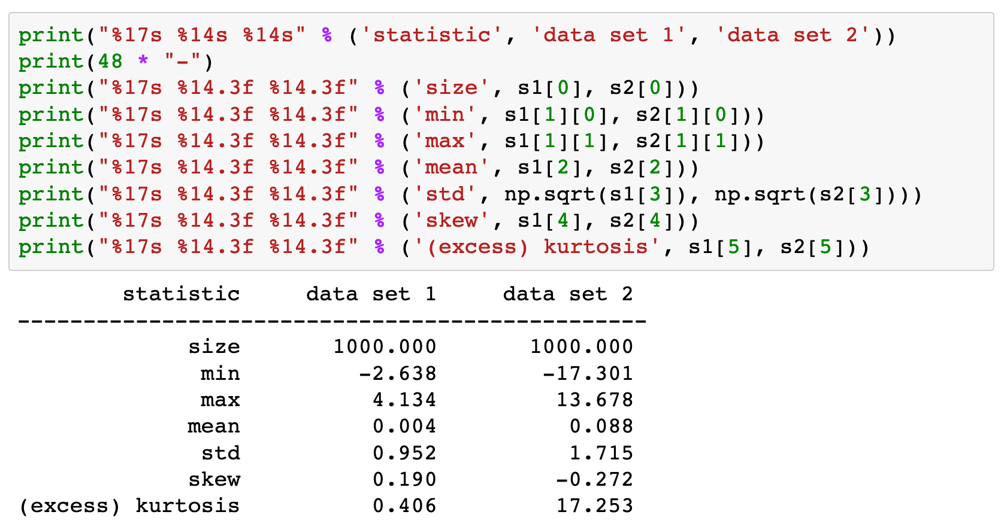
Push Right (C Style)

Slide 50
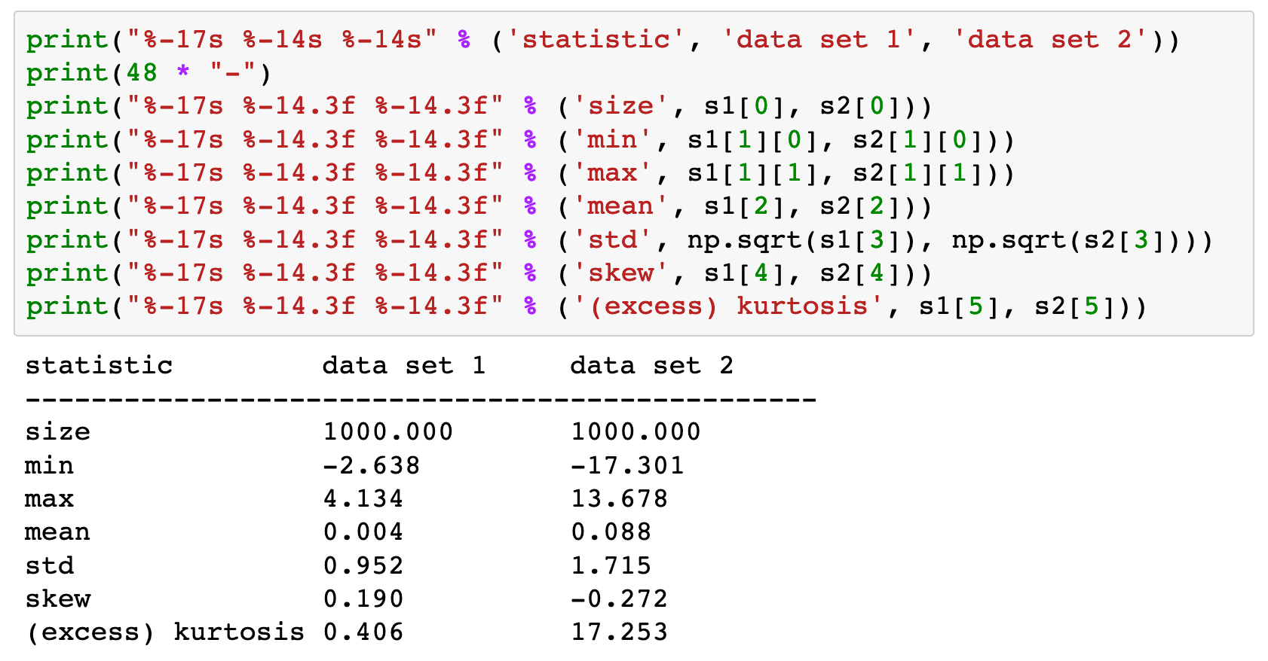
- Push Left (C Style)

Slide 51
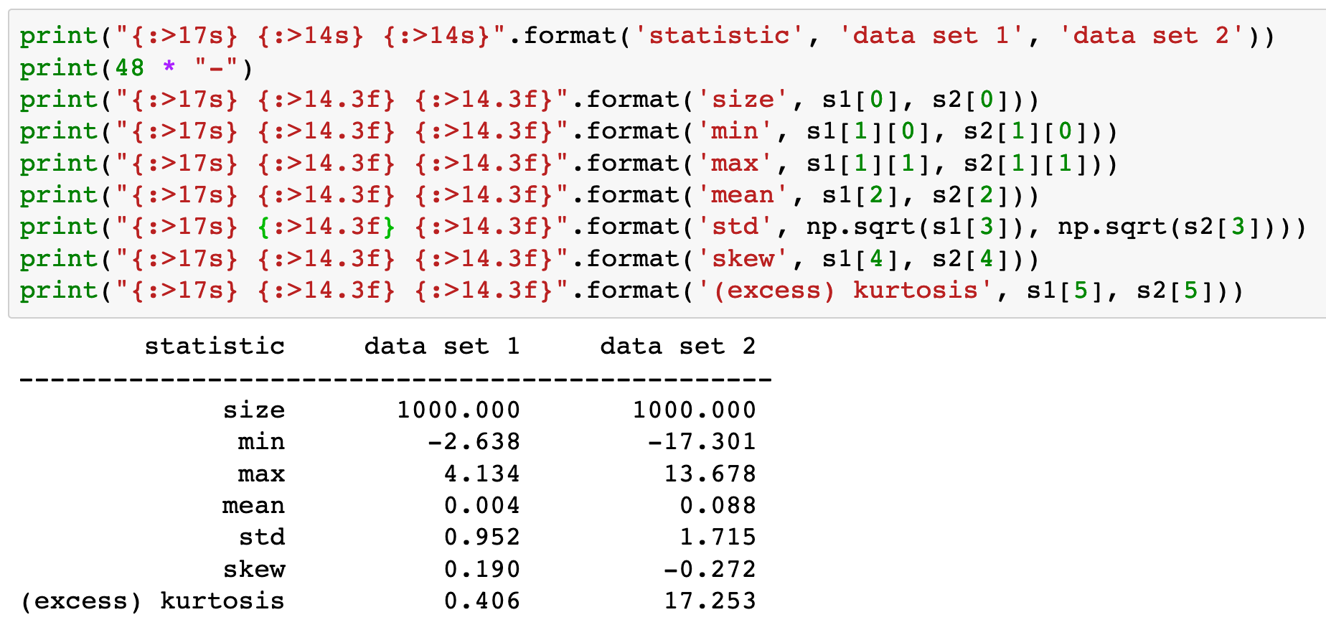
> Push Right (Python Style)

Slide 52
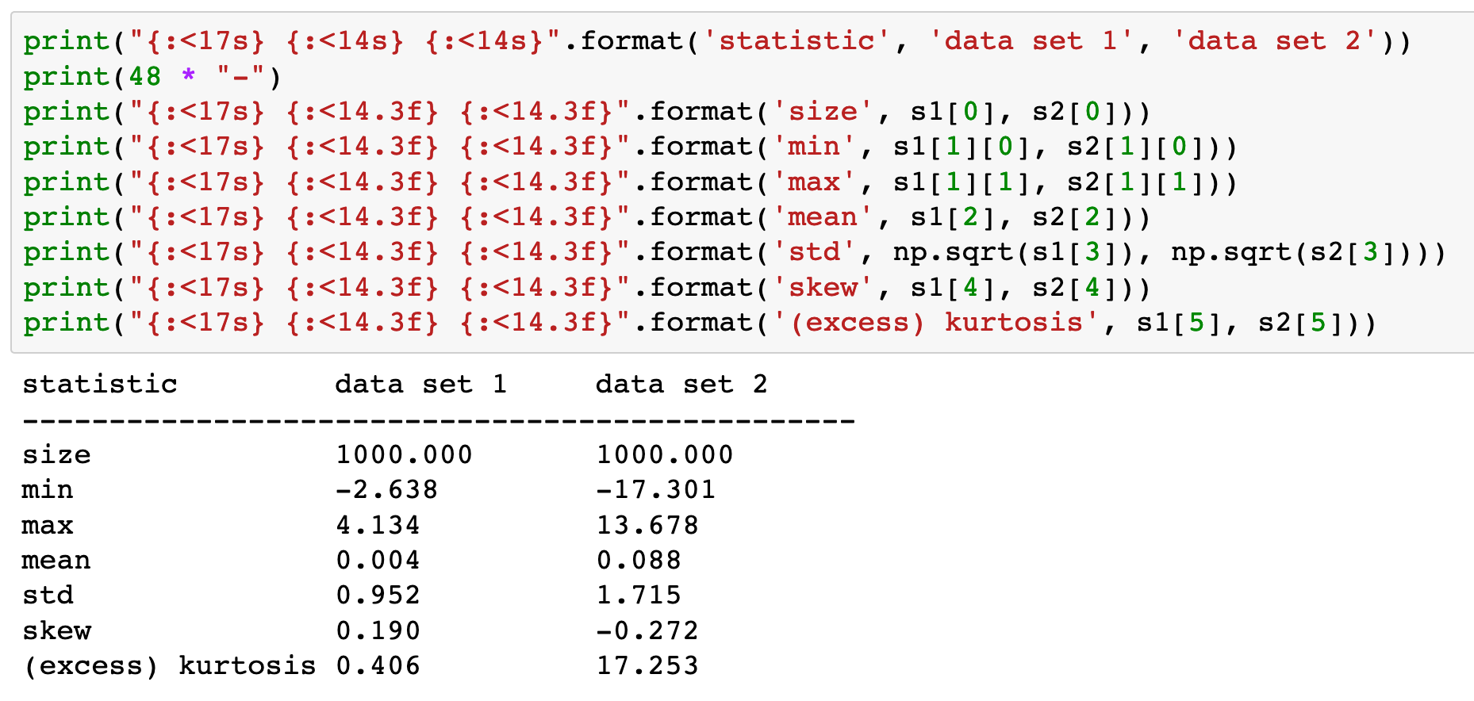
< Push Left (Python Style)

Slide 53
Now
Let’s Play with Code

